Slide 1
Performance Management System
Department of Human Resources
Metropolitan Government of Nashville & Davidson County

Slide 2

Performance Appraisals vs. Performance Management

Slide 3
Performance Appraisals
The process by which a manager or consultant;
  examines and evaluates an employee's work behavior by comparing it with preset standards;
  documents the results of the comparison, and;
  uses the results to provide feedback to the employee to show where improvements are needed and why.
Performance appraisals are employed to determine who needs what training, and who will be promoted, demoted, retained, or fired.
Performance evaluations document the following cases:
  completion of probationary or work test periods
  increments, promotions, advancements, layoff actions, or re-employment eligibility
  other personnel decisions

Slide 4
Challenges of Performance Appraisals
Challenges:
Assessments may be seen as personal attacks
Done improperly, the can create unnecessary stress
Can be time consuming and overwhelming to supervisors with many employees
Often based on subjective assessment and subject to rater error and inconsistencies
Can be a waste of time if not done appropriately
They can create a negative overall experience

Slide 5

Challenges of Performance Appraisals

Slide 6
Performance Evaluations?
A recent survey from the Society for Human Resource Management found that 72% of organizations conduct formal appraisals only once a year.
  Only 2% of employees gave their employer an A grade for their performance management.
  Source: https://social.hays.com/2015/08/31/7-reasons-why-you-should-be-conducting-performance-appraisals-more-often/#_ftn1

Slide 7
Performance Management
Performance management is;
  an ongoing process of communication between a supervisor and an employee that occurs throughout the year;
  in support of the accomplishing of the strategic objectives of the organization.
Two Processes
  Performance Acceleration: “How do I improve performance from employees?”
    Coaching
    Getting to know your employee
    Setting clear expectations and goals
    Providing ongoing feedback
  Performance Measurement
    Objective measurement of performance
    Documentation
    Clear feedback/commentary

Slide 8
Performance Management
Setting Organizational Expectations
Establish Employee Goals and Objectives
Create Performance Plan
Provide Ongoing Feedback
Evaluate Performance

Slide 9
Advantages of Performance Management
Advantages:
Employees feel valued
Set new goals
Resolve grievances
Strengthen bonds
Refocus your team
Oversight on current projects
Assess the training needs of your team

Slide 10
Substantial Benefits
For Metro:
Greater results for all customers
Greater accountability and greater alignment
Creates documentation for future personnel decisions
Improves performance
Improves morale
For the employee:
Employees feel valued
Better communication with staff
Fair and consistent evaluations
For You…The Manager:
Improved measures for entire department
Resolve grievances
Strengthen bonds
Oversight on current projects
Assess training needs of your team

Slide 11

Metro and The Performance Management Process

Slide 12
What Does History and Research Teach Us About Performance Evaluations?
History, research, and even neuroscience, all point to the fact that the traditional models of performance evaluations are typically viewed as stressful and punitive, and can actually negatively impact behavior in the workplace.

Slide 13
What Does History and Research Teach Us About Performance Evaluations?

Slide 14
What Does History and Research Teach Us About Performance Evaluations?
Like many organizations in both the public and private sectors, Metro recognizes the need to evolve the performance management process, continually revising our current practices to be more positive and engaging in order to creating an environment of employee development and collaboration.

Slide 15


Metropolitan Government of Nashville & Davidson County
Performance Management System Review & Recommendations
September 2016

Slide 16




Performance Management Maturity Model
Research identifies four levels of a progressively more advanced process that leads to increasingly superior talent and operational outcomes
Level 4 | Responsive Some Practices Customized for Key Workforce Segments • Many Managers Excel at Ongoing, Targeted Feedback, Coaching, Recognition & Development Plans • Strong Leader-Led Accountability for PM • PM Regularly Optimized • Effective PM Practices Considered a Part of the Employer Brand
Level 3 | Purposeful & Integrated Clear Purpose of PM • Managers Proficient with Regular Goal Reviews, Coaching, Feedback & Development Plans • Recognition Occurs Outside Appraisals • Leaders Encourage PM Accountability • PM Highly Integrated with Other TM Processes
Level 2 | Standardized Clearer Purpose of PM • Standardization of Most Practices (i.e., Goal-Setting, Rating Scale, Competencies, Technology) • Support for Coaching, Ongoing Feedback & Development Plans • Some Integration Between PM & Other TM Processes
Level 1 Inconsistent Unclear Purpose of PM Beyond Using Appraisals to Justify Compensation Decisions • Little Standardization of Practices • Low Support for Manager Coaching & Ongoing Feedback • Little or No Technology or Talent Management (TM) Integration
Increasing Maturity and Impact
B e r s i n b y D e l o i t t e
6
Source: Bersin by Deloitte, 2012

Slide 17
Performance Management maturity assessment
 | Level 4 Responsive | Level 3 Purposeful and Integrated | Level 2 Standardized | Level 1 Inconsistent
Purpose of Performance Management (PM) | Purpose of PM clearly communicated and is based on the organization’s business strategy and culture (i.e., goal alignment, coaching & development planning) |  | Increased clarity on purpose of performance management, although typically limited to driving performance alone | Unclear why the organization engages in performance management
Standardization | Balance of standardization and customization of practices, responding to the needs of key workforce segments | Practices standardized, some customization for targeted talent segments or unique needs of geo-markets (cultural, language) | Increasing standardization of performance management practices | Inconsistent, variable process and practices across organization
Coaching and feedback – philosophy and support | Managers highly effective at responding to the needs of employees through ongoing coaching, feedback. Leaders role-model behavior | Goal reviews, feedback and coaching occur frequently. Leaders and Managers hold each other accountable for engaging in PM practices and behaviors | Greater promotion of, and support for coaching and development through job aids and online courses | Appraisal a feedback mechanism of last resort, with employees often not receiving feedback at other times throughout the year. Low organizational support for coaching
Frequency | Continuous, regular conversations and feedback | Quarterly goal and feedback mechanisms | Annual review with semi-annual check- in | Sporadically or annually
Who Evaluates | Multi-rater extended to include peers, customers, internal clients and/or subordinates | Multi-raters used for feedback and appraisal – secondary managers, second-tier managers | Employee and direct manager | Direct Managers
Recognition | Managers highly effective at regularly acknowledging contributions for progress as well as specific behaviors. Recognition also provided by peers, customers, etc. | Recognition occurs outside of appraisals. Formal processes may exist, and informal recognition may take place in team meetings. May include peers, other (non-supervisory) managers | Annual and semi-annual reviews as vehicle, formal processes may exist (Spot awards, etc.) | Annual review viewed as recognition vehicle. Manager- driven
Talent Management Integration | Appraisal further leveraged to identify talent and skills gaps for TA and workforce planning purposes. Organization views the strength of its performance management practices as a part of its employer brand and focuses on improving and communicating them to that end | Appraisal as a tool to identify development needs of both employees and leaders, inform career path directions and development, and mobility decisions | Appraisal as a tool to identify development opportunities and goals, to inform succession management decisions | Appraisal completion primarily for compensation decisions. Development planning might be separate discussion.
Technology | Integrated TM system, with PM data integrated and feeding Learning, Succession, LD, WFP processes | Automated, with simplified processes, criteria, user friendliness, etc. | Automated process, available at annual cycle | Little or no technology used
Process Optimization | Performance management practices are regularly checked for impact and efficiency and improved | Performance management practices are checked periodically for efficiency | Performance Management practices are checked for compliance | Processes not checked, optimized or evaluated for impact
Key:
Metro Nashville Maturity Rating
7

Slide 18
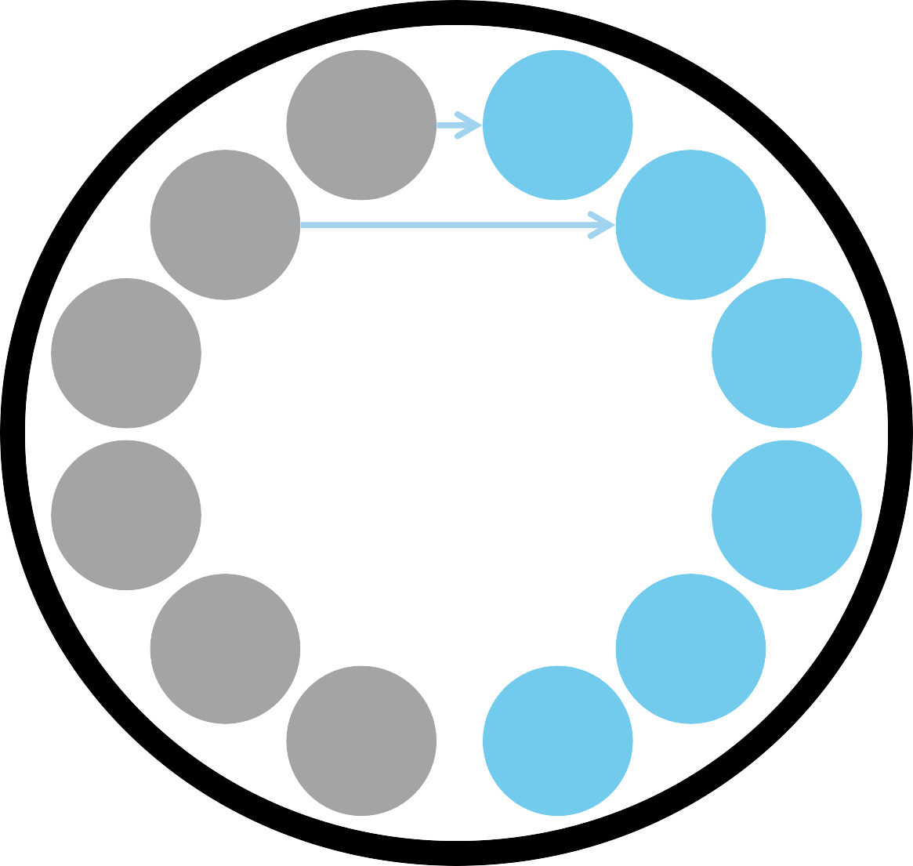




Performance Management principles are shifting dramatically
Reducing the “threat” of evaluation involves making the process more employee-centered and supportive of their aspirations, while meeting organizational performance requirements
Annual, One-Time
Ongoing, Continuous
Burdensome, Fixed
Flexible, Agile, Simple
Assumption Based
Data Driven
Future Outlook
Centralized, Deferred
Local, Real-Time
Investments in development planning reduce voluntary and high performer turnover while increasing the average revenue by employee¹
Appraisal Focused
Development Focused
Remediation
Strengths
15
¹ Source: High Impact Performance Management, Bersin by Deloitte, 2011

Slide 19
Performance Management Forms

Slide 20
Changes to the Performance Evaluation Form
Major Components of the Performance Evaluation Form:
  Section A: Major Job Responsibilities
    Rating Scale: 3-point
  Section B: Core Competencies
    6 Core Competencies
    Definition of competencies provided
    Elimination of Supervisor Competencies
  Section C: Expected Work Behaviors
    Attendance
    Compliance with Rules
    Observation of Work Hours
  Section D: Goal Achievement

Slide 21
Section A: Major Job Responsibilities
A. MAJOR JOB RESPONSIBILITIES: List the responsibility, rate the performance level, and provide comments
to support your ratings. *NOTE: A rating of 1 or 3 must be documented.
Responsibility | 1 | 2 | 3 | Comments
1.
2.
3.
4.
Section A identifies a minimum of one and a maximum of eight performance measures and major job responsibilities.
Each item under Section A is assigned a whole number score of:
  1 (Needs Improvement)
  2 (Successful)
  3 (Exceptional)
    Note: A rating of a “1” or “3” MUST be documented.
    It is NOT recommended that raters use decimals, such 1.5, 2.5, etc...
    Yes, you’ll probably end up with a decimal point in overall average (that’s fine).
Section A also provides a space for the supervisor to add comments.

Slide 22
Section A: Major Job Responsibilities
Major Responsibilities versus Tasks
  Job Responsibility
    The aspect of the job for which one is accountable and measured; High Level
  Tasks
    The activities one performs in order to fulfill a job responsibility; Specific

Slide 23
Section A: Major Job Responsibilities
Job Responsibility
Task 1
Task 2
Task 3

Slide 24
B. CORE COMPETENCIES: Mark a rating indicating how well the employee displays the competency and provide comments to support your ratings. Also, evaluate supervisors on the four additional competencies on the Supervisor Competencies form.
Section B: Core Competencies
Competency | 1 | 2 | 3 | Comments
1. Adaptability/Flexibility: Displays willingness and ability to adjust to change in assignments, schedule, rules, and procedures in a timely manner.
2. Communications: Receives and relays information in a clear, accurate and respectful manner. Conveys information effectively through verbal and written means.
3. Customer Relations: Displays a positive, cooperative, and respectful approach when interacting with customers and focuses on meeting customer needs and gaining results.
4. Dependability: Takes personal responsibility for the quality and timeliness of work, and achieves results with little oversight.
5. Initiative: Demonstrates appropriate independent action, self-application, self-improvement, and innovation to achieve results and to address gaps and issues with supervisory guidance.
6. Teamwork/Peer Relations: Displays a positive, cooperative, and respectful approach when interacting with other employees. Demonstrates ability to work effectively in a team to achieve results.
Section B identifies 6 Core Competencies and defines the standard by which an employee is to be rated directly on the form.

Slide 25
Section B: Supervisor Supplemental Form

Slide 26
Section C: Expected Work Behaviors
C. EXPECTED WORK BEHAVIORS: Mark the appropriate rating and provide comments if needed. Comments must be
provided for a rating of Unacceptable.
Behavior | Acceptable | Unacceptable | Comments
1. Attendance
2. Compliance with Rules
3. Observance of Work Hours
*A rating of Unacceptable for any of the above items requires the following:
Documentation of specific problem(s) and corrective and/or disciplinary actions taken.
Authorization of next level manager. Signature_____________________________________
Authorization of departmental/Metro Human Resources office. Signature_____________________________________
Section C ensures that the employee reflects three fundamental work behaviors:
  Compliance with all Metro/Civil Service rules
  Attendance
  Observance of work hours
These fundamental work behaviors are rated either as “acceptable” or “unacceptable.”
Every “unacceptable” rating must be documented and include authorizations by next level manager and your department’s/Metro’s HR office. A “Performance Improvement Plan” should also be generated.

Slide 27
Compliance with Rules
Does the employee know the rules applicable to your department? Rules include Civil Service Rules, specific departmental rules, and safety issues
Does the employee have to be reminded of rules?
Does the employee show willful disregard for the rules or break them?
Is the behavior repeated, even after a verbal or written correction?

Slide 28
Attendance Issues
Did the employee properly notify you of absences?
Were illnesses / sick leave documented according to rules and policies?
Does the employee request “emergency” vacation?
Is there a pattern of absences (i.e., requesting Monday or Friday off frequently)?
Are there any incidents of the employee being AWOL (absent without leave)?
Are absences appropriately reported through your Time & Attendance mechanisms?

Slide 29
Observance of Working Hours
Is the employee frequently late reporting for work or returning from lunch or breaks?
Does the employee frequently leave early?
Are the reasons for being tardy or absent believable?
Do problems with observance of working hours impact other employees and the operation of the department?

Slide 30
What about Safety?
Safety is no longer listed as a Core Competency:
  Safety is MAJOR component of employees role:
    Section A: Major Job Responsibility
  Safety is expected part of everyday behavior:
    Section C: Compliance with Rules

Slide 31
Section D: Goal Achievement
D. GOAL ACHIEVEMENT: (This section should be completed only if you used the Performance Plan form to set goals at the beginning of the rating period. This is intended for developmental purposes and is not calculated as a part of the performance rating.) Indicate whether or not the employee achieved their performance and developmental goals for the year. Provide comments if needed.
Goal | Successful | Unsuccessful | Comments
1.
2.
3.
4.
5.
Part of the employee development process, as part of the overall performance management system.
  This section is not calculated as part of the performance rating.
  Only to be used in conjunction with the Performance Plan Form.

Slide 32
Remember . . .
Reviews should be based on elements that can be measured or justified by documentation.
Make sure your supervisor or Appointing Authority agrees with your evaluations.

Slide 33

Continuous Process
Proper performance evaluation is not an annual event; it is a continuous process you engage in throughout the year.

Slide 34

Supplemental Tools for Success

Slide 35
Performance Plan
Used in conjunction with the Performance Evaluation form.
Opportunity for supervisors and employees to discuss expectations and future accomplishments for the coming evaluation period.
Major job responsibilities should be outlined on this form in order to clarify misconceptions and establish expectations
Section for performance goals should be used to create job-oriented, SMART goals.

Slide 36
Performance Plan
Developmental goals are learning-oriented, and should include goals to acquire skills, knowledge, and experiences that will empower employees to:
  Remain effective at the employee’s current job, or;
  Support the employee’s ability and desire to take on new responsibilities or grow in their career.
Multifunctional
  Conversation 1 form
  Performance Improvement Plan Form
Documentation!

Slide 37
Performance Feedback Form
The Performance Feedback form provides a tool to encourage two-way feedback between supervisors and employees on a quarterly basis, and document those conversations.
Documentation!

Slide 38
Summary
Metro is committed to philosophically changing the way that we evaluate performance. Our goal is to leverage research and industry trends to transform our Performance Management system into a process to evaluate, recognize, and cultivate our employees, in order to create more positive experiences for managers, supervisors and employees, with the ultimate goal of better serving our customers.

Slide 39

It’s up to You !
You – as supervisor – provide the link between your department’s goals and the individual employees who do or do not fulfill those goals.

Slide 40
Thank you!
For more information or additional support, please contact Metro Human Resources

