Slide 1
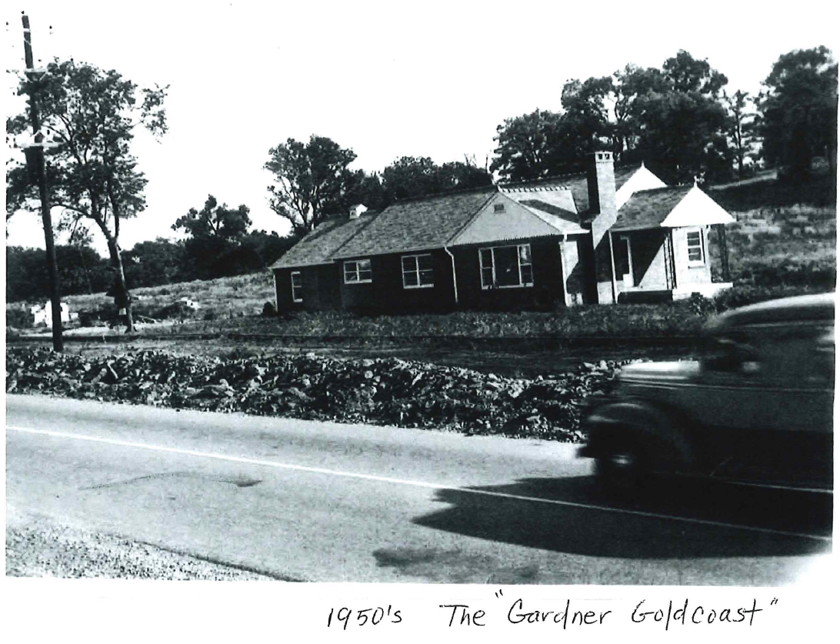
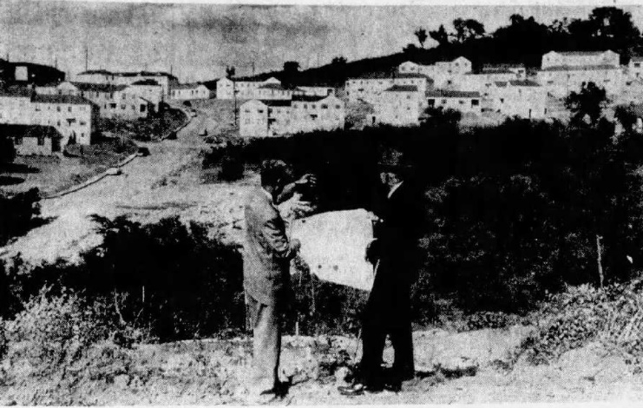
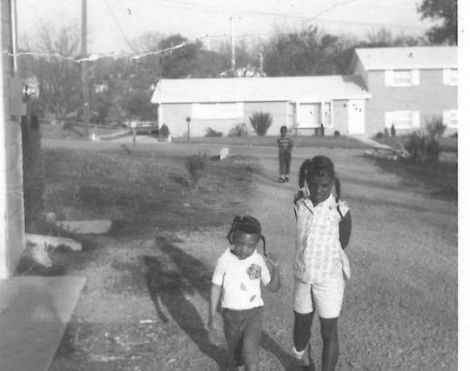
Underrepresented Communities History Project
Caroline Eller, Metropolitan Historical Commission

Slide 2
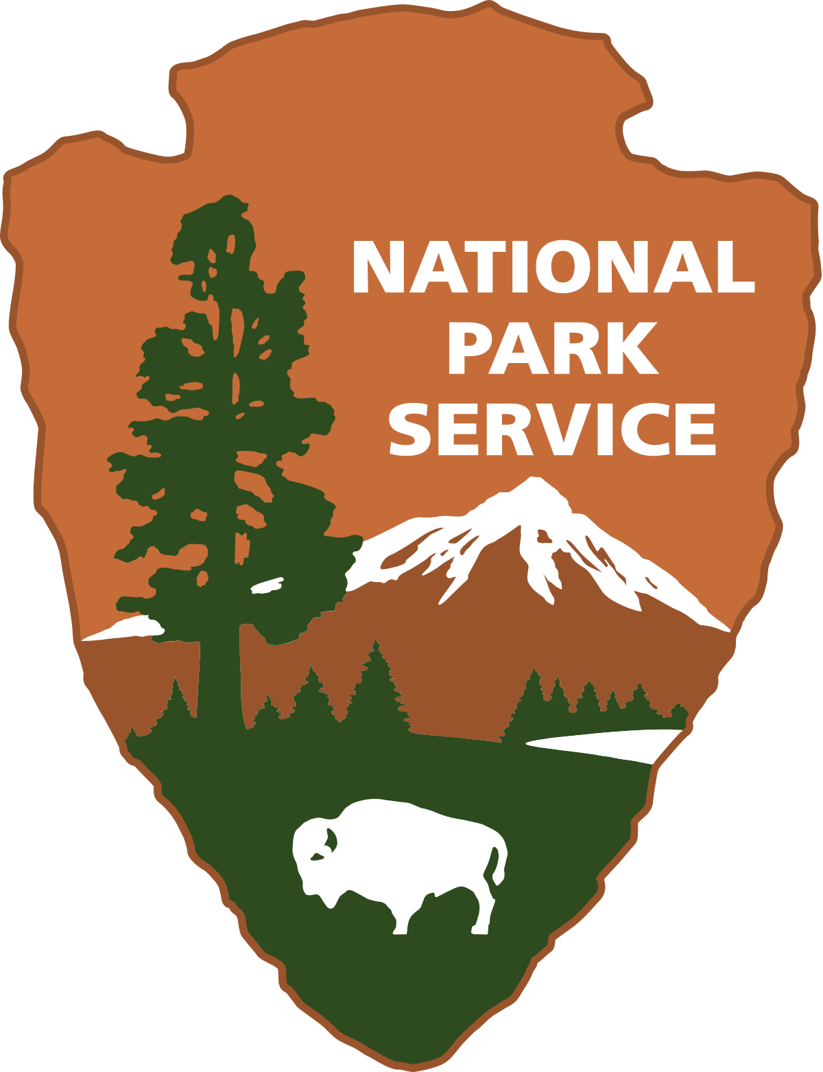
Project Overview
Goal: Record the developmental history and architecture of mid-20th century African American residential districts in Nashville/Davidson County; complete National Register documentation
Funding: National Park Service Underrepresented Communities (URC)
program which “works towards diversifying listings submitted to the
National Register of Historic Places” – $57,963 award to Metro
Historical Commission (2023)
Scope of work:
1) National Register of Historic Places (NRHP) countywide context – covers where, how, why these districts developed
2) associated district nomination - Haynes Heights (with ability to nominate more districts in future) – only this district will be designated

Slide 3
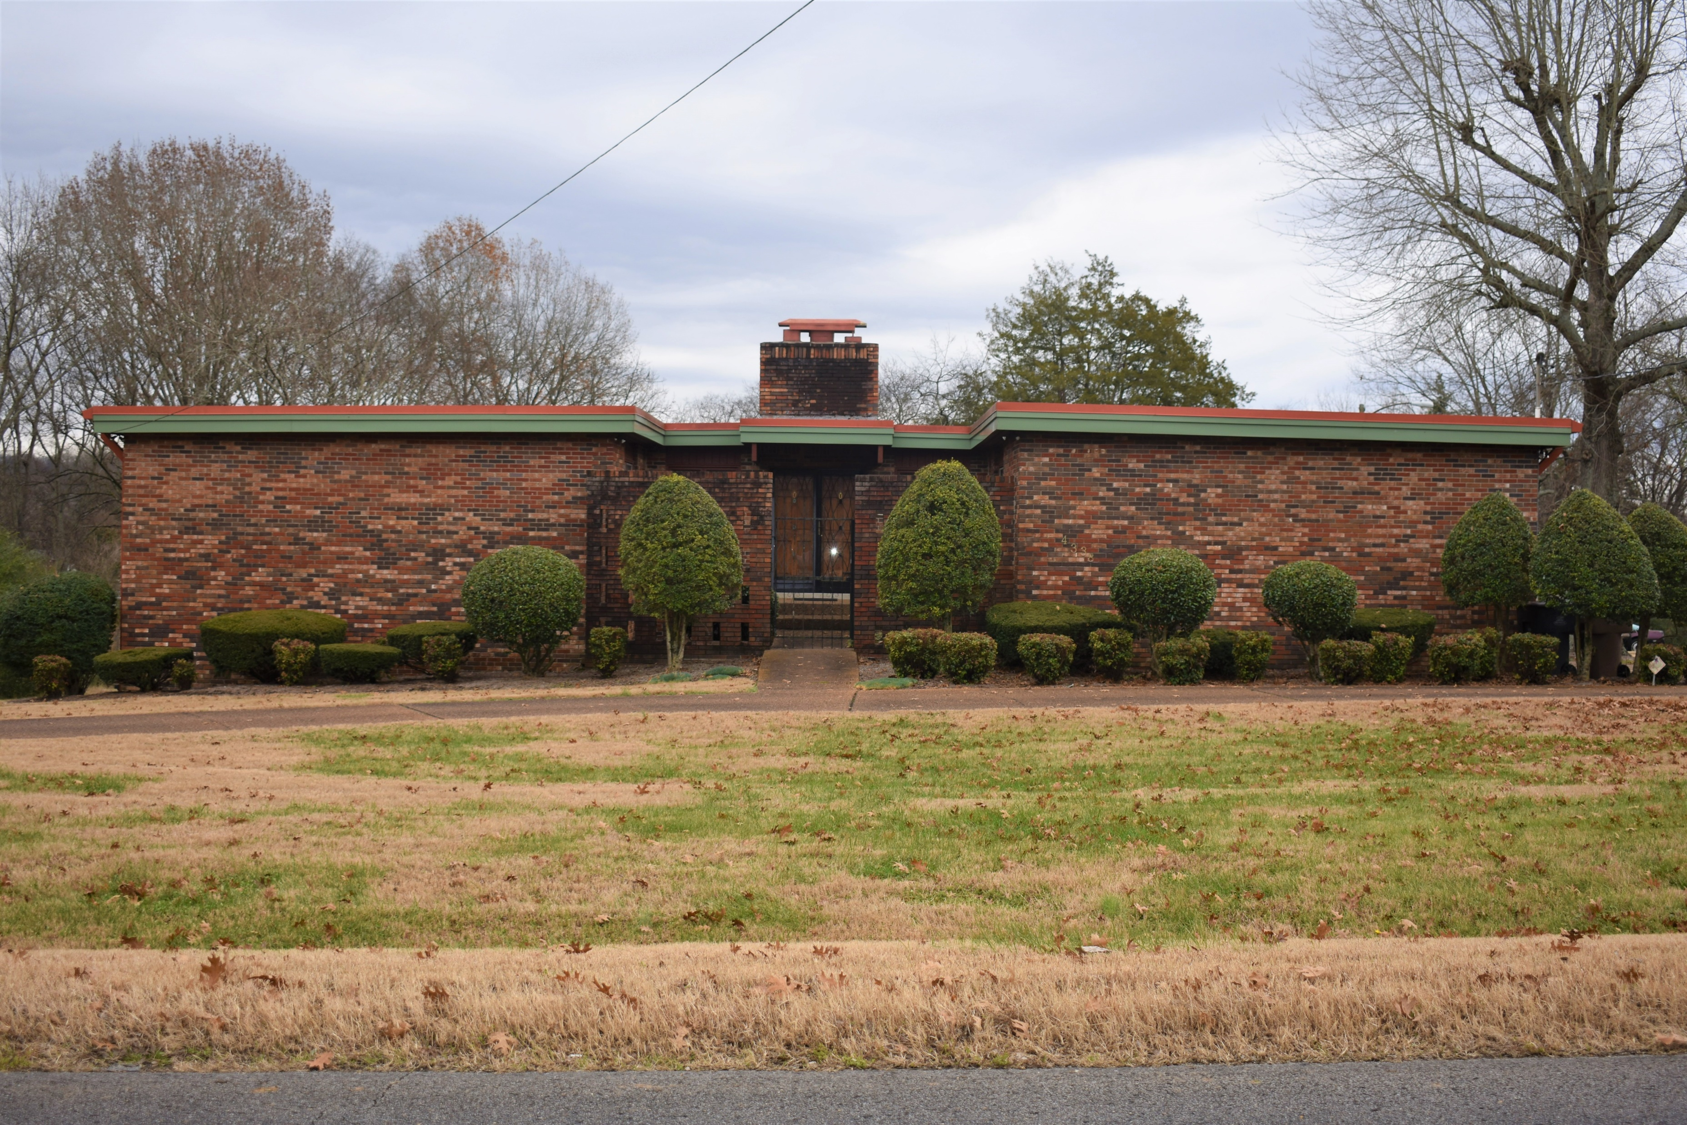
Project Overview (cont’d)
Through historical research, project reviews, public inquiries, and designation discussions, MHC identified a “study list” of districts, including (but not limited to):
Bordeaux Gardens/Bordeaux Hills Gold Key Estates Normal Heights
Clintondale Haynes Acres Oak Park
College Hill Haynes Estates Royal Crest
Cumberland Gardens Haynes Heights Royal Garden Estates
Edgehill Haynes Manor
Enchanted Hills Haynes Meade
Fisk Park Haynes View
Gardner’s Gold Coast Hillhurst Acres
Gardner Meadows Lathan-Youngs
Right: Contemporary style home in Enchanted Hills.

Slide 4
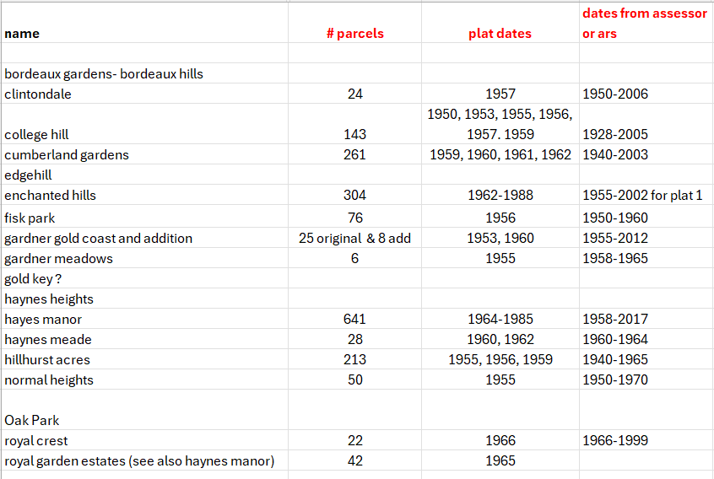
Plats date from 1950-1965
Largest district= Haynes Manor (641 parcels)
Smallest district= Gardner Meadows
(6 parcels)

Slide 5
Where, How, and Why did these districts develop?

Slide 6
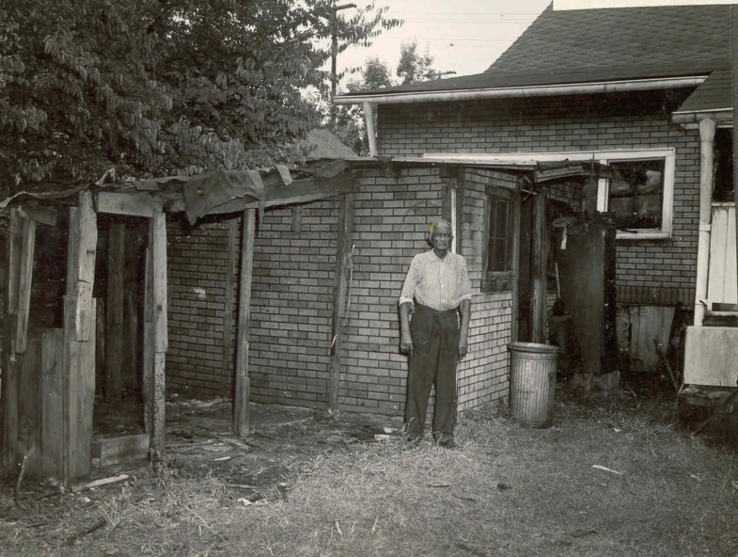
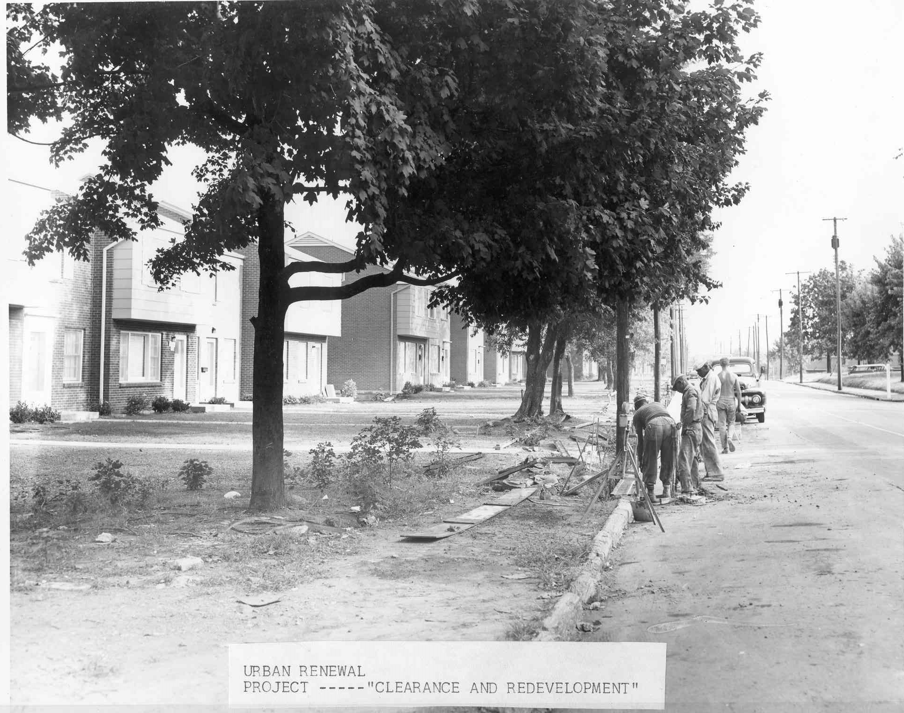
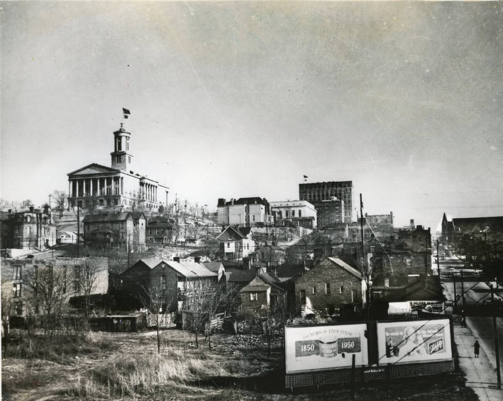
Urban Renewal
Above and upper right: urban renewal projects, c. 1961 by Jim Angela. Right: Hell’s Half Acre in 1950 prior to clearance for Capitol Hill Redevelopment, courtesy Nashville Public Library, Metro Archives.

Slide 7
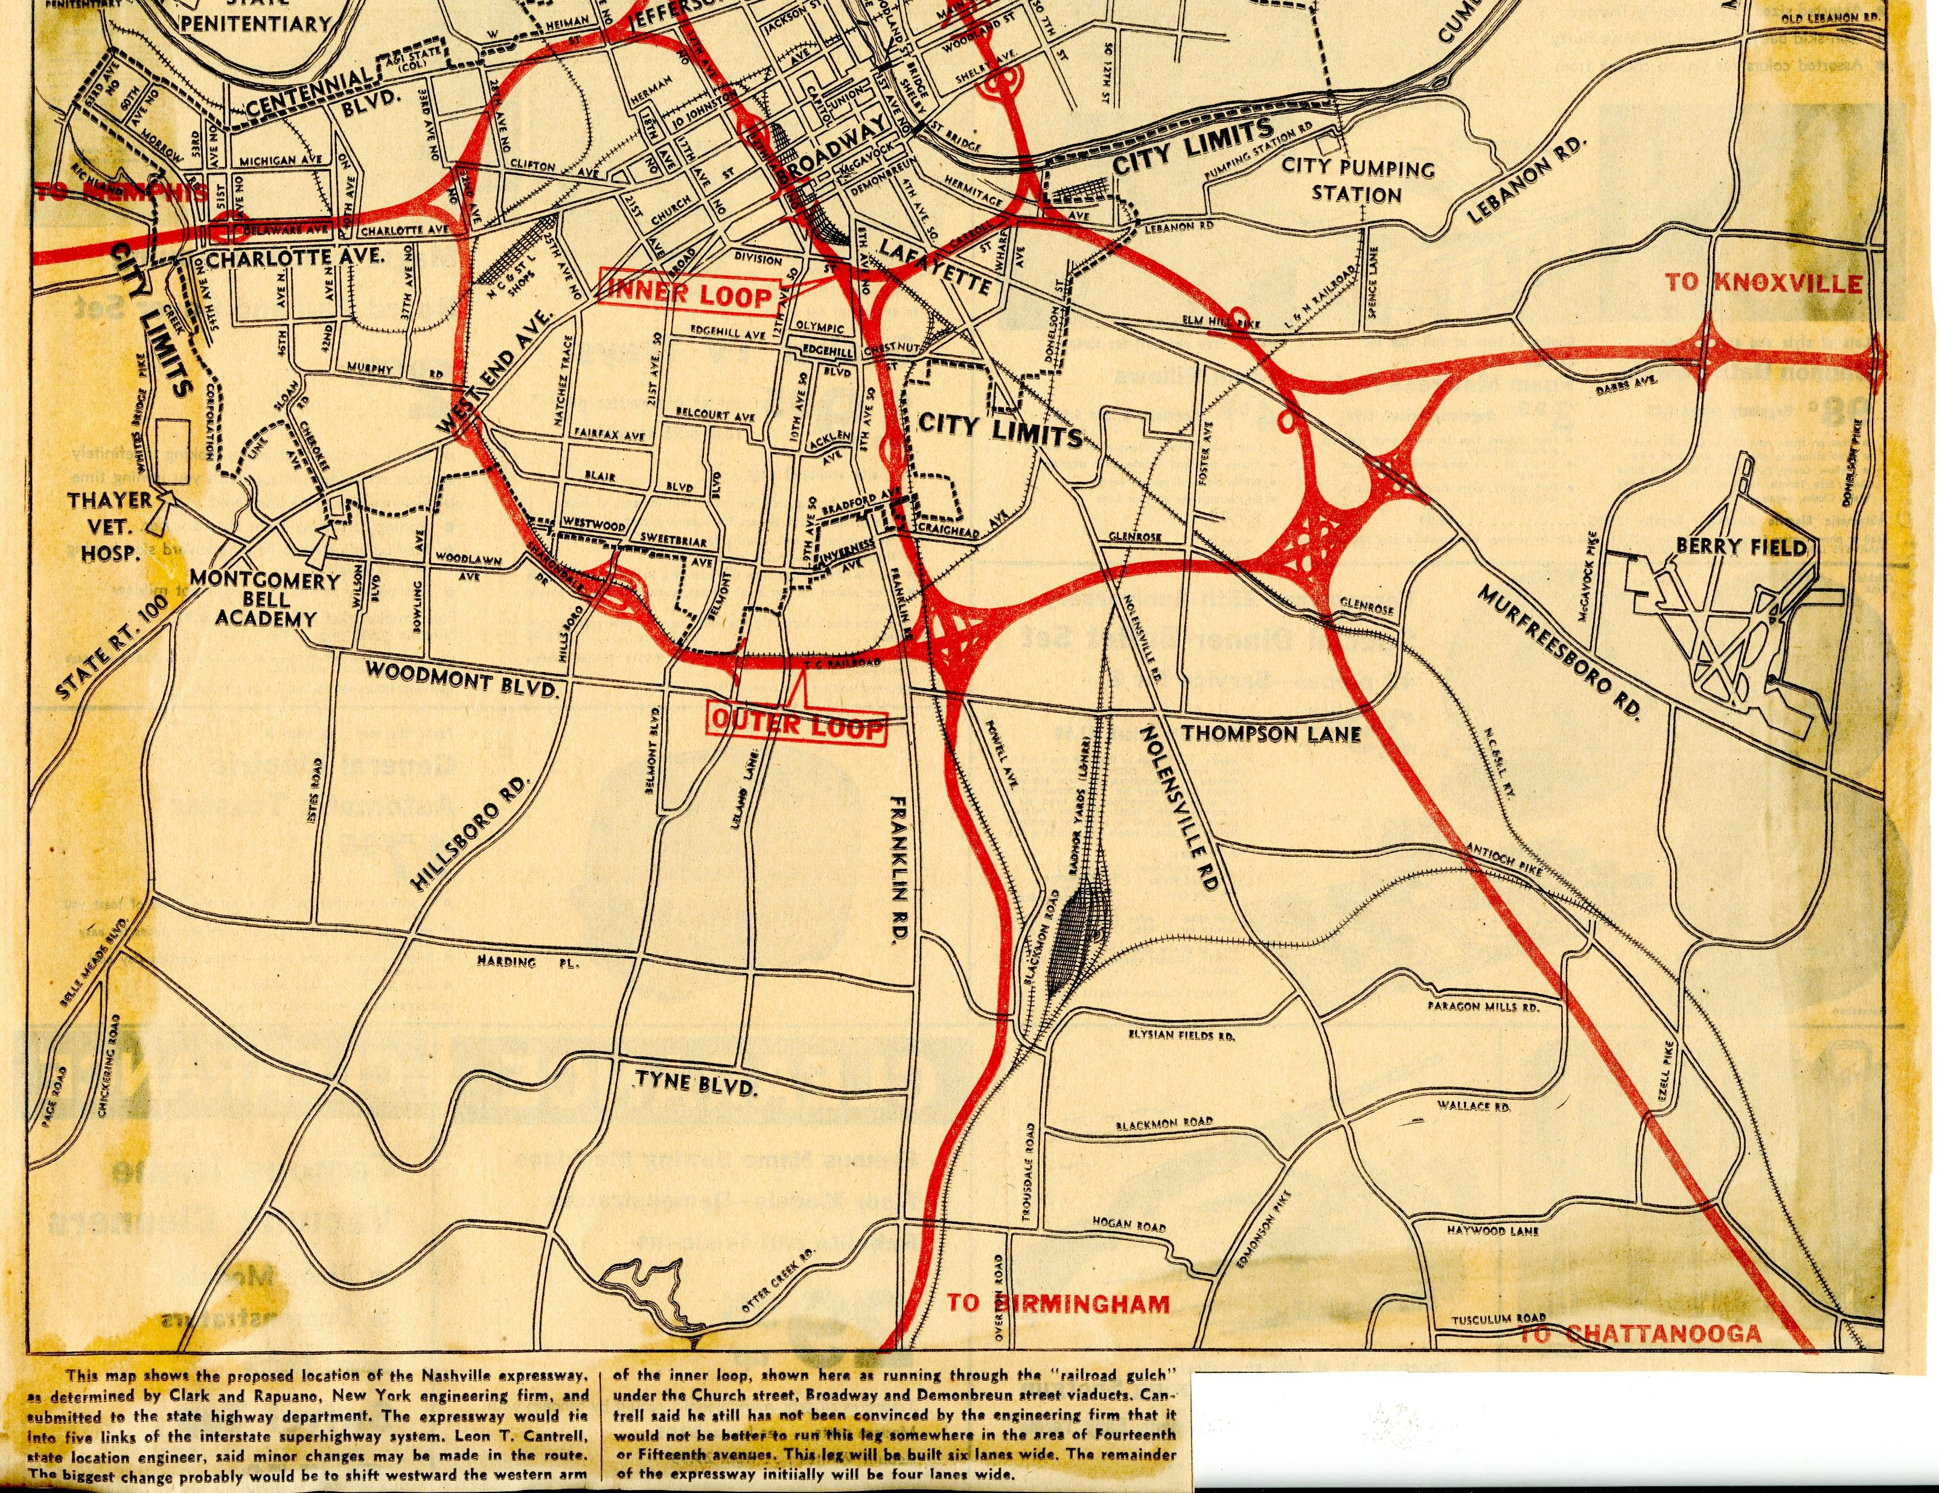
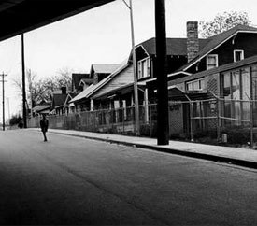
Interstate projects
Above: Map of Interstate proposal, 1956, Metro Archives.
Right: View of 2400 block of Jefferson Street showing interstate overpass, undated.

Slide 8
Discriminatory housing practices
Racially restrictive covenants sometimes placed by homeowners, can be found in deeds
Redlining maps:
the term "redlining" originated from the maps created by the Home Owners' Loan Corporation (HOLC) in the 1930s
neighborhoods evaluated and graded based on racial/ethnic makeup; maps used by HOLC to assess mortgage risk
minority areas often deemed "hazardous,“ shaded red and denied access to mortgage loans and other financial resources
long-term consequences include systematic disinvestment, perpetuating racial and economic inequality; residential segregation; concentrated poverty; limited opportunities for Black and minority communities; persistent disparities in housing, education, health, and economic outcomes

Slide 9
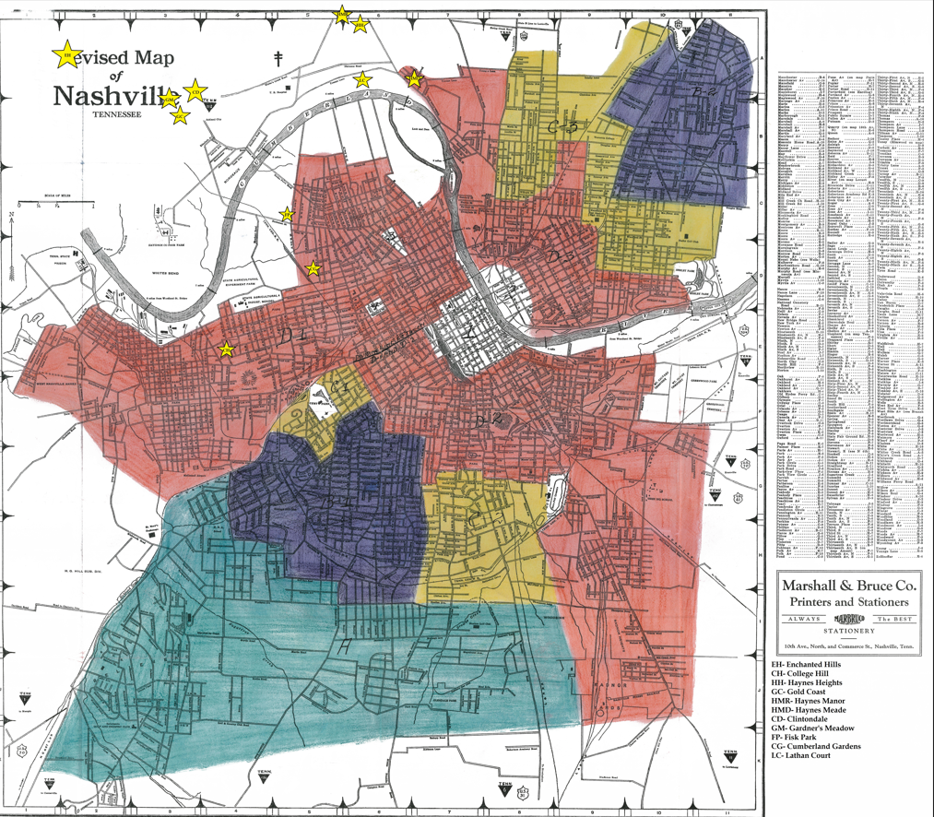
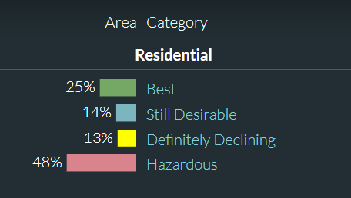
Redlining Maps
Neighborhoods categorized into four categories (A, B, C, and D), with "D" or "Hazardous" areas, often those with high concentrations of Black or minority residents
Starred locations represent several districts from our study list
Left: Nashville “redline map” (Marshall & Bruce, c. 1940) from Mapping Inequality

Slide 10
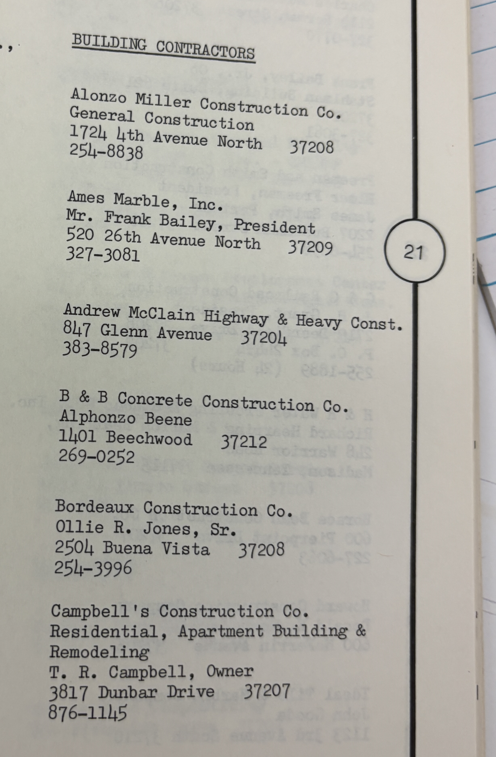
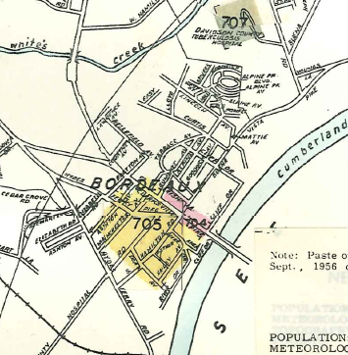
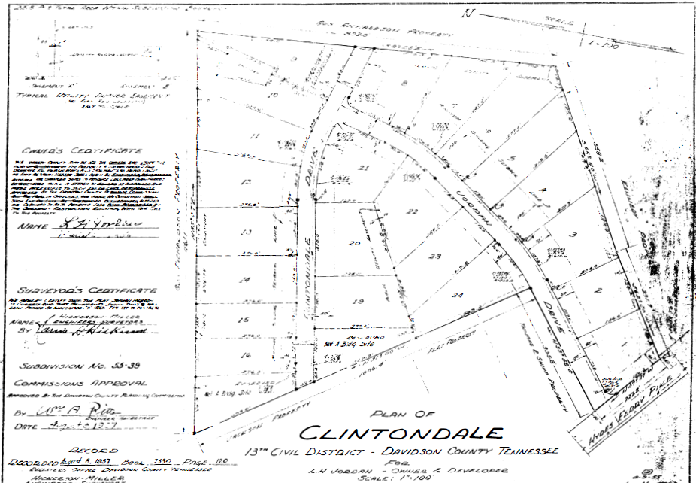
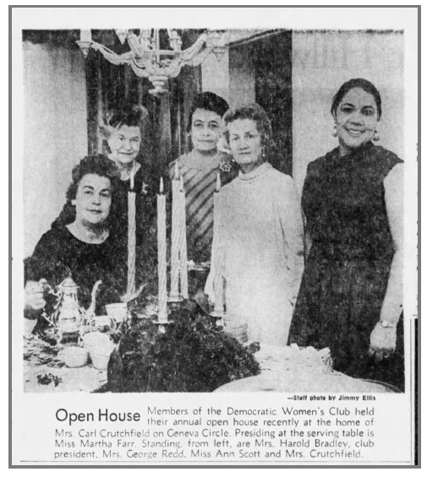
Historical Research
Deeds, plats, newspapers, reports, oral histories, maps,
historical images, directories
Above: Plan of Clintondale (1957); Black Business Directory (1983); 1957 Sanborn map.
Right: College Hill clipping (1968).

Slide 11
Representative Districts

Slide 12
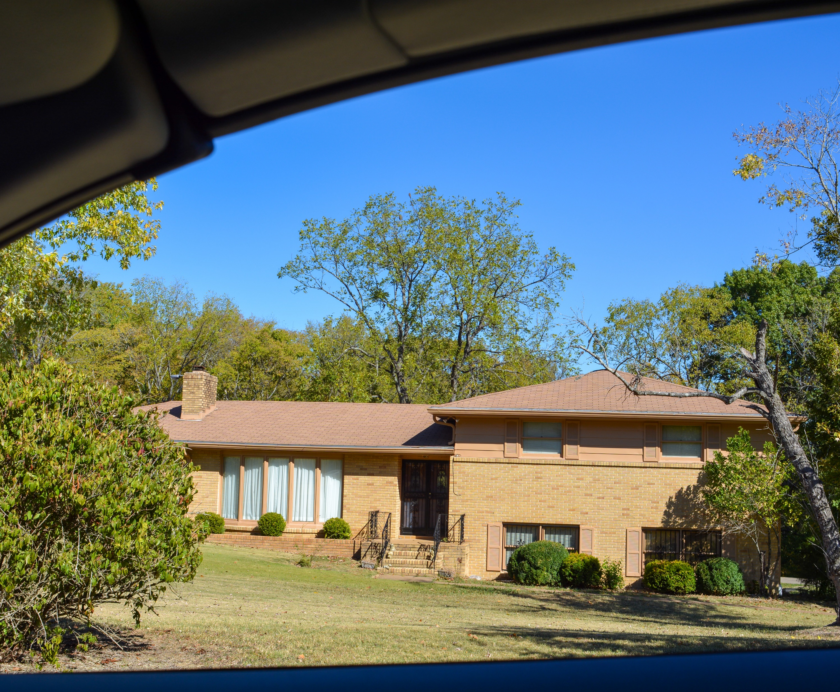
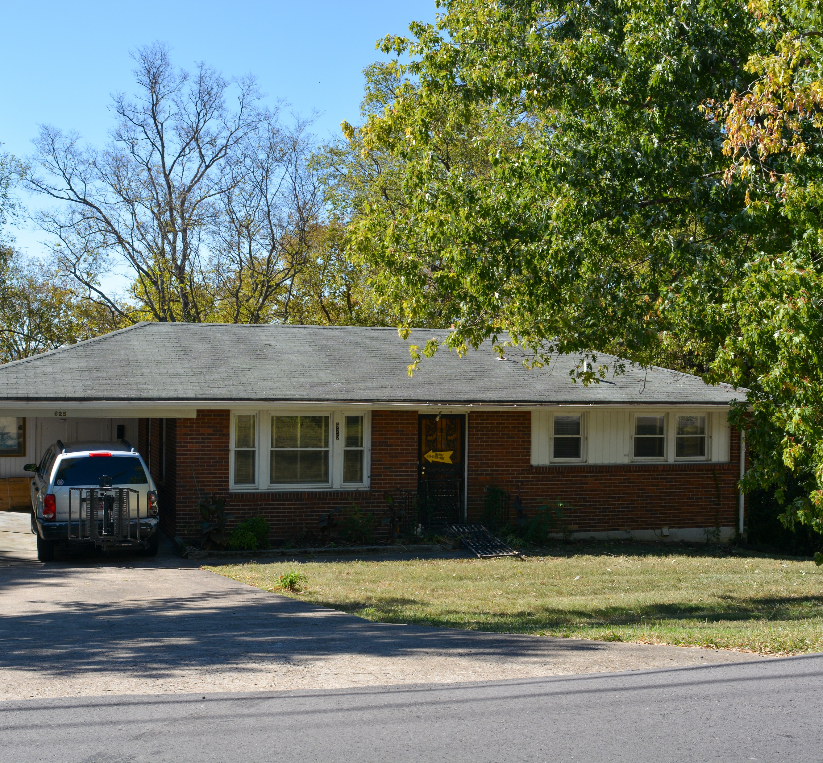
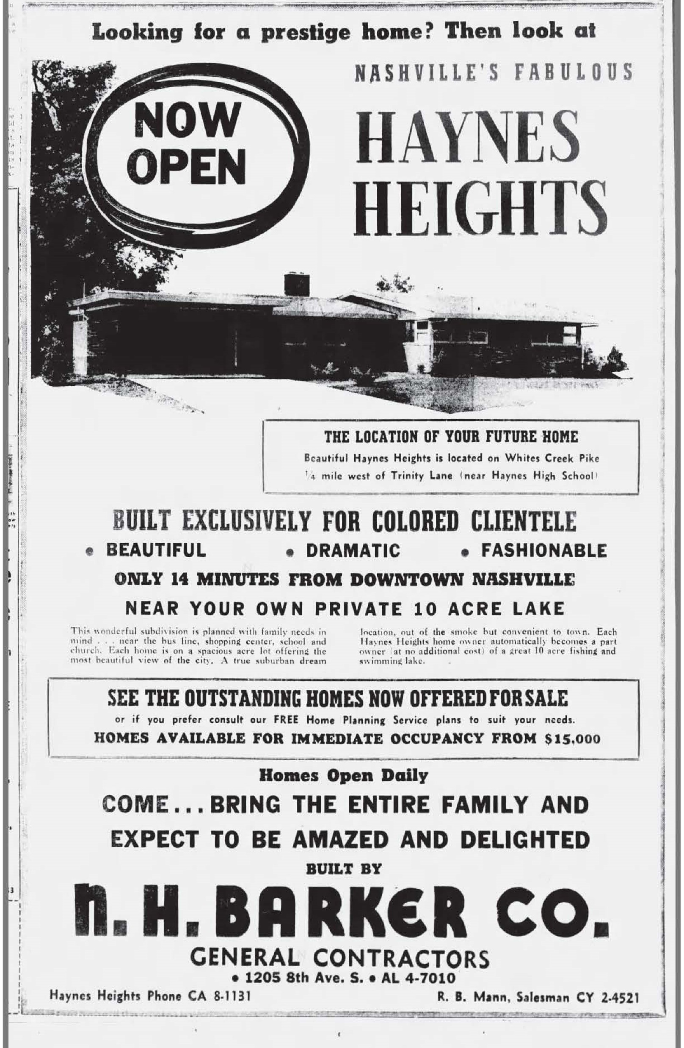
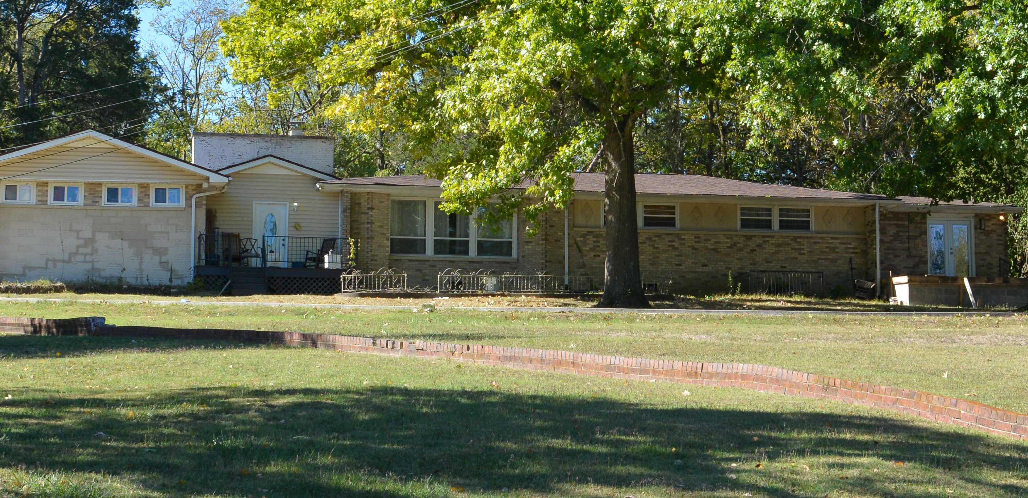
Haynes Heights
Platted 1955
Home dates: 1950-2019
Minimal Traditional, Ranch,
Raised Ranch, Split Level,
Transitional Ranch
Developed by and for African
Americans during the Jim Crow
Era; populated by doctors,
lawyers and educators
Right: Haynes Heights real estate ad, The_Tennessean_Sun__Dec_9__1956_

Slide 13
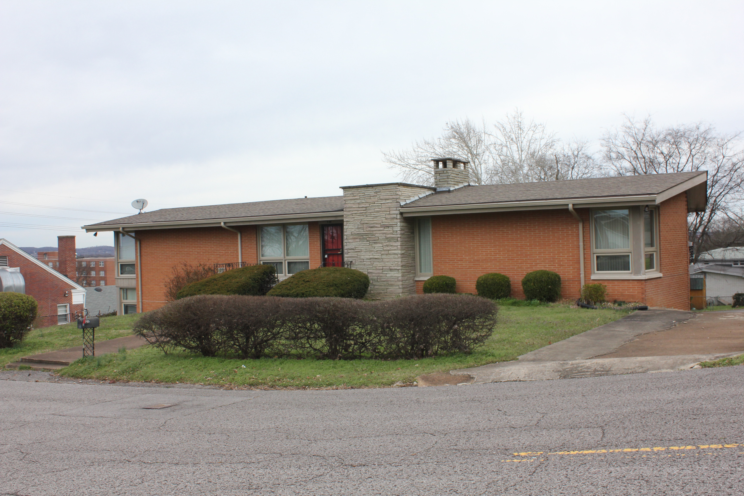
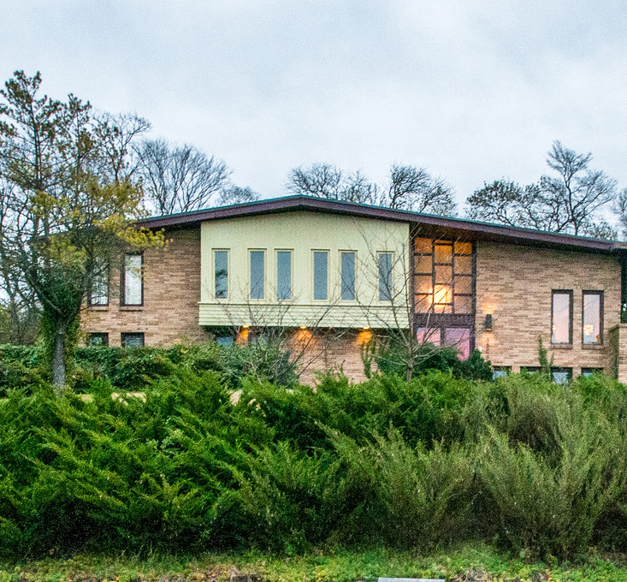
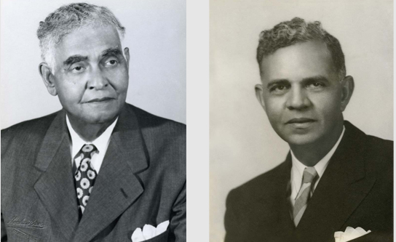
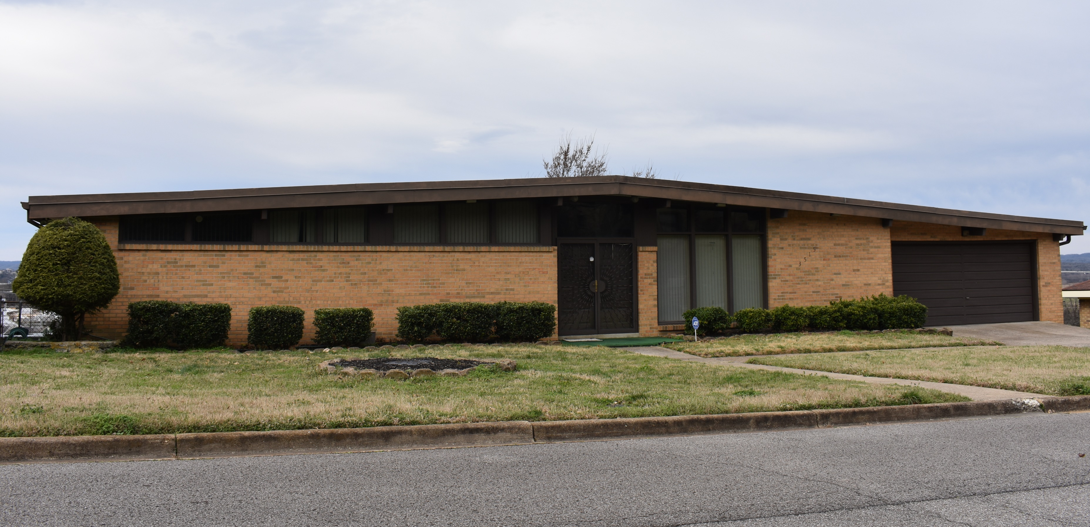
College Hill
Platted 1950-1959
Home dates: 1928-2005
Contemporary, Minimal Traditional, Ranch, Split Level, Transitional Ranch
Nashville's first major African American housing project developed by private enterprise--McKissack & McKissack served as the architects, owners, and developers
Right: Brothers and architects Moses III (left) and Calvin McKissack, undated photo.

Slide 14
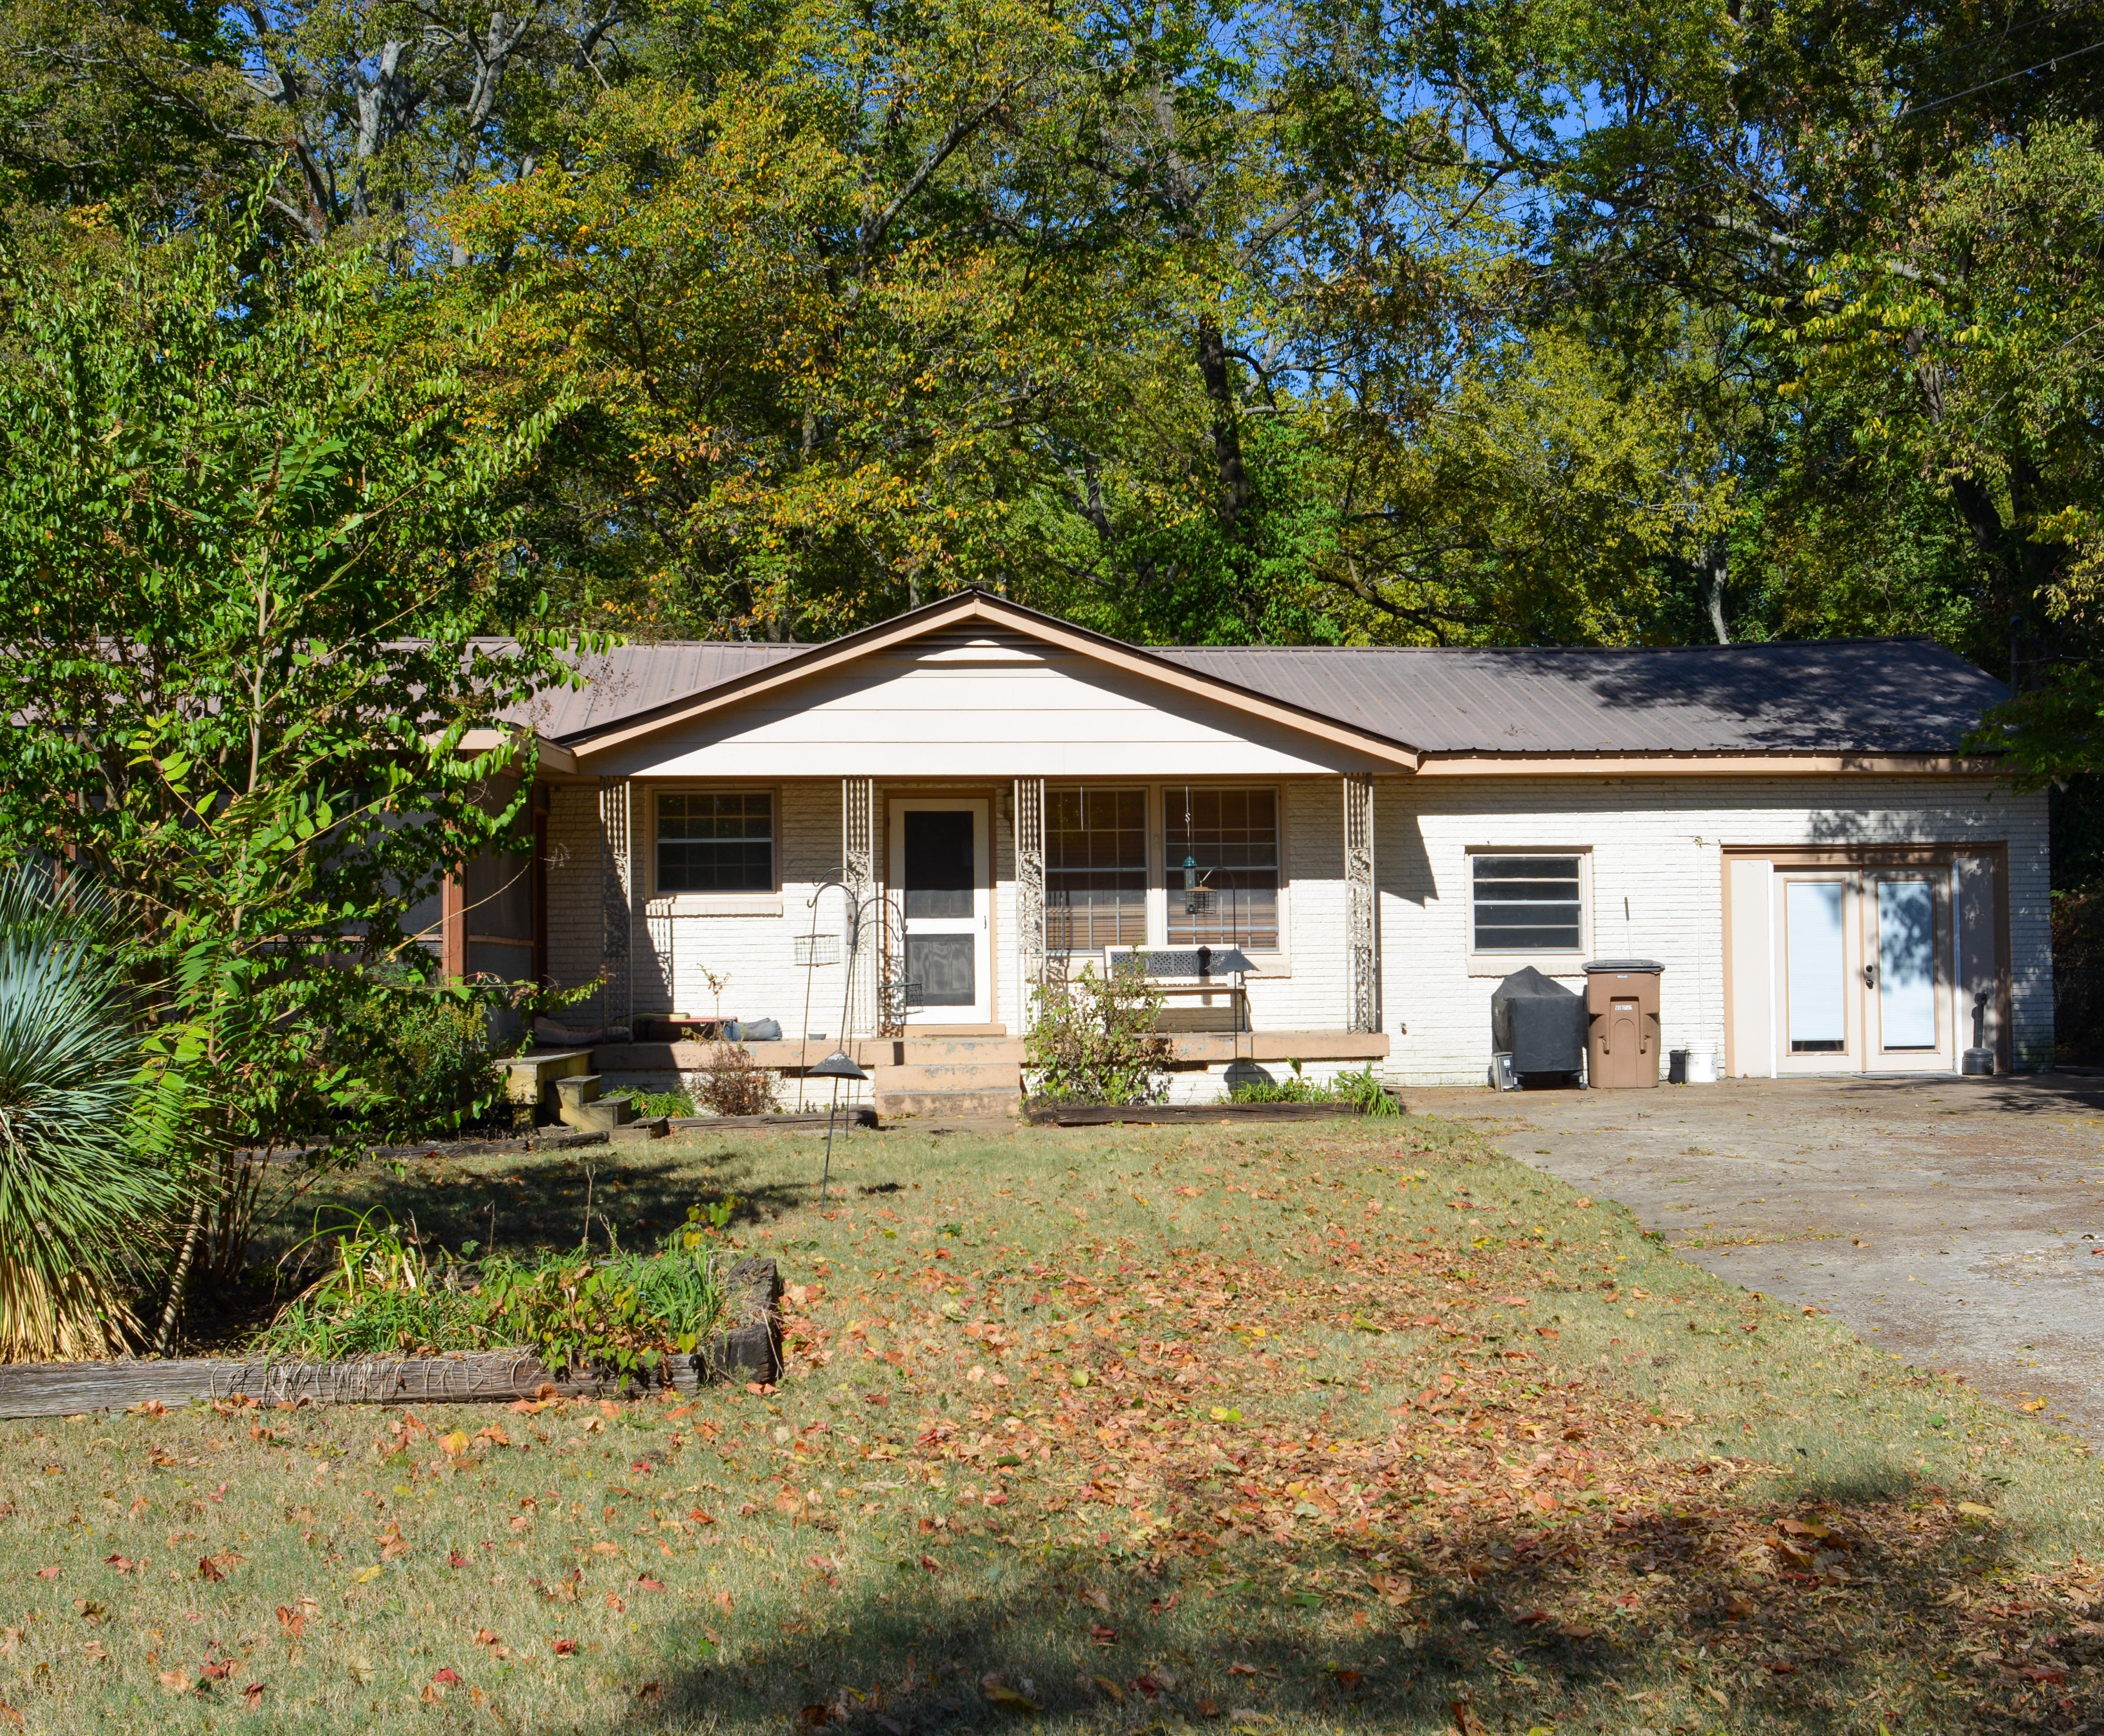
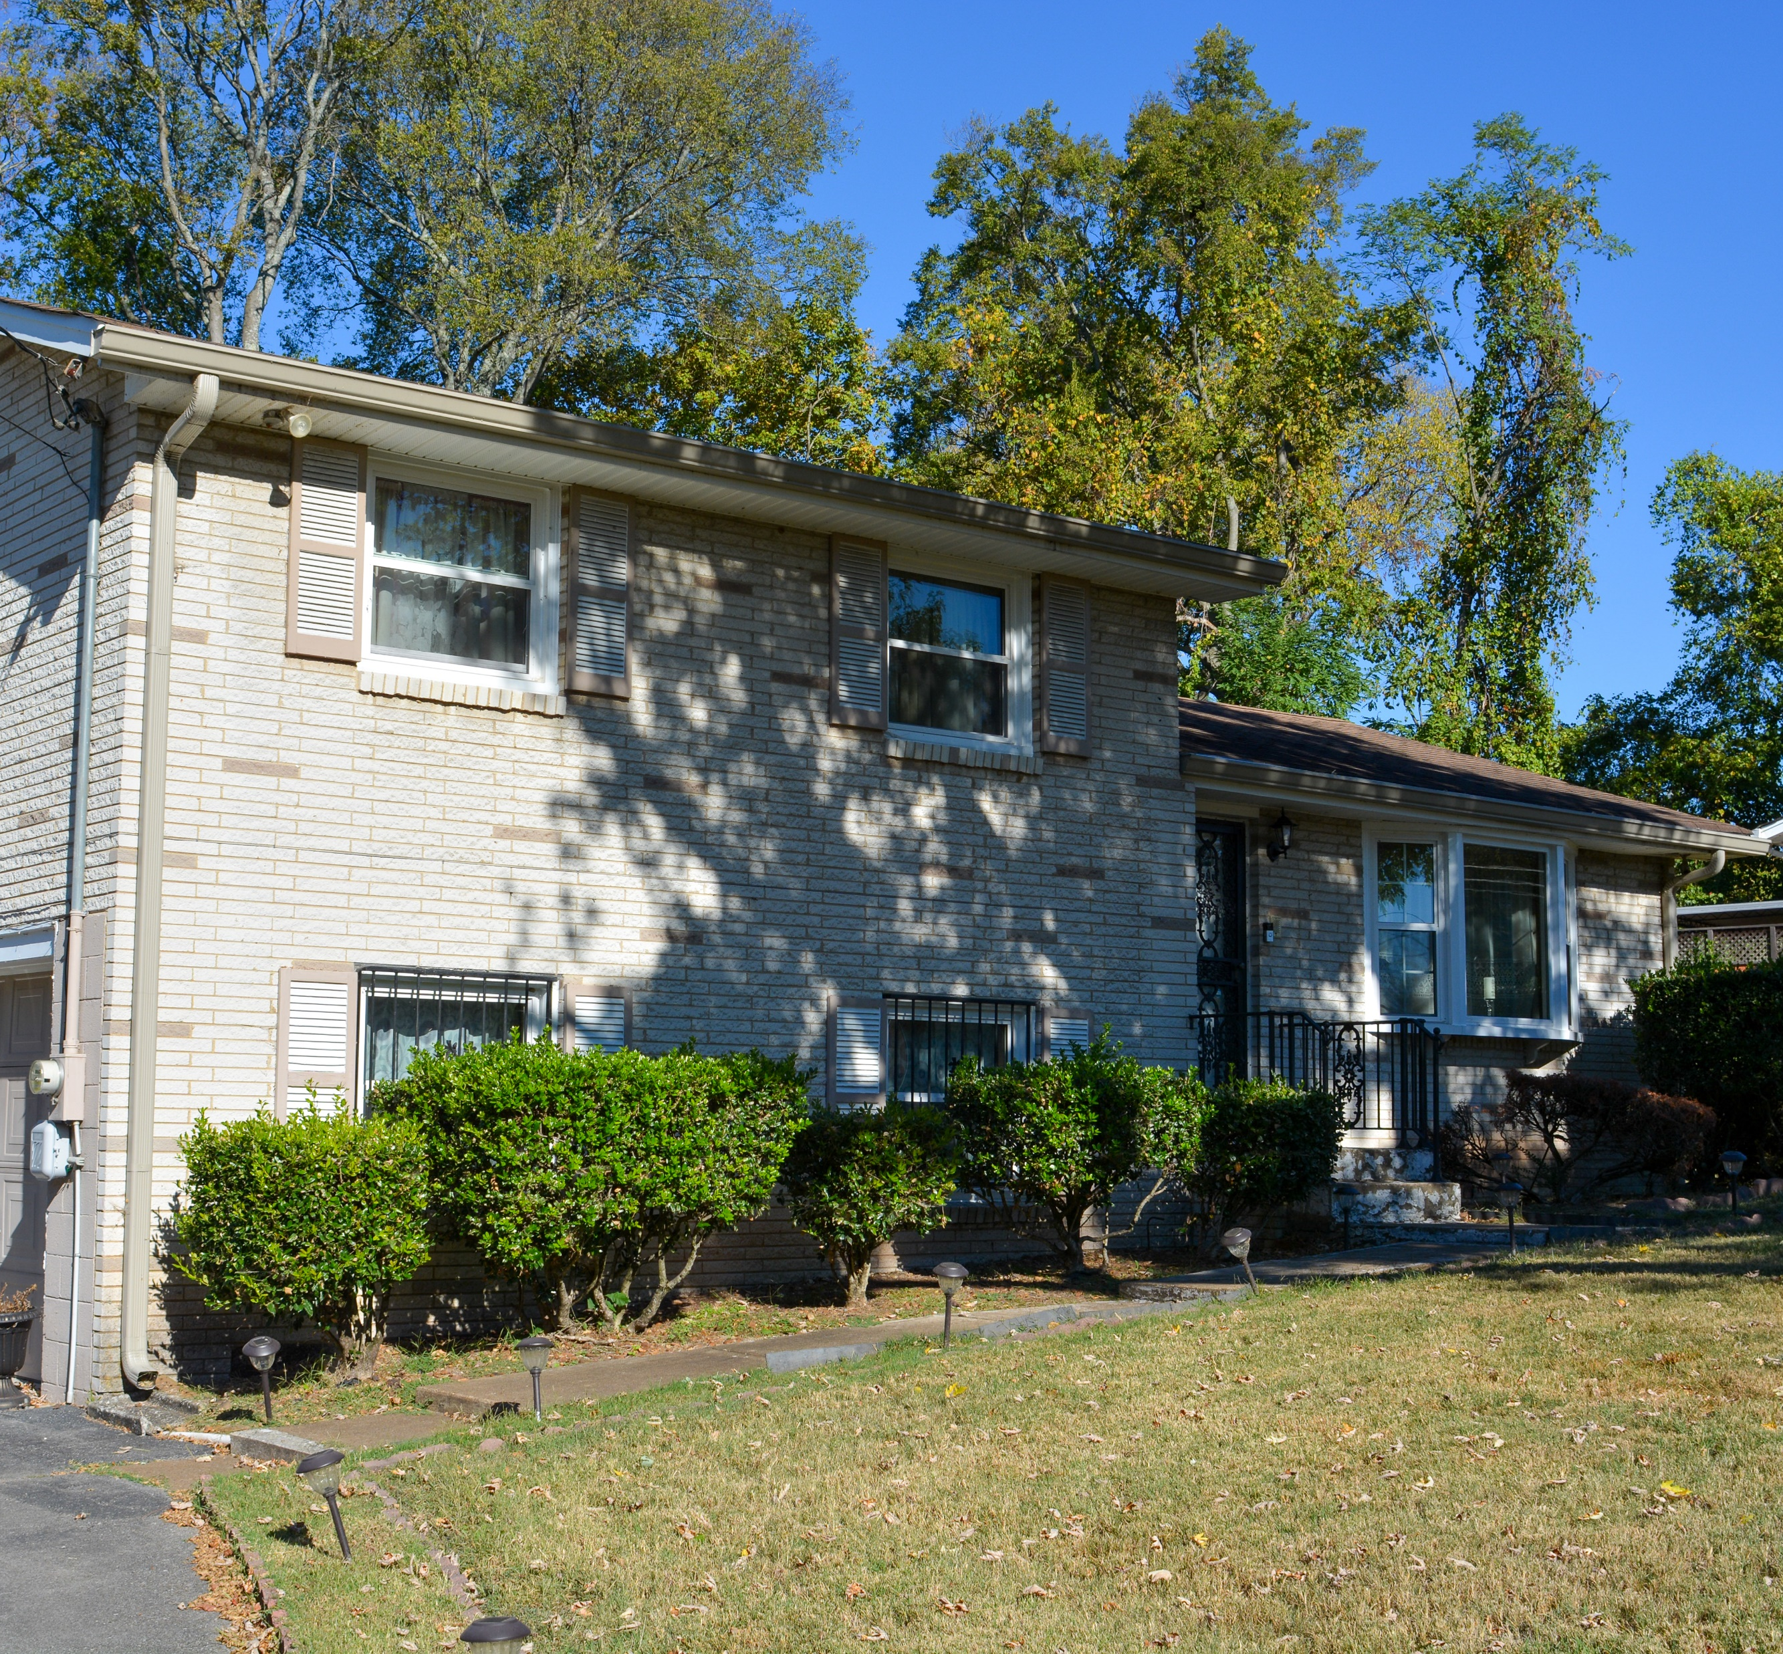
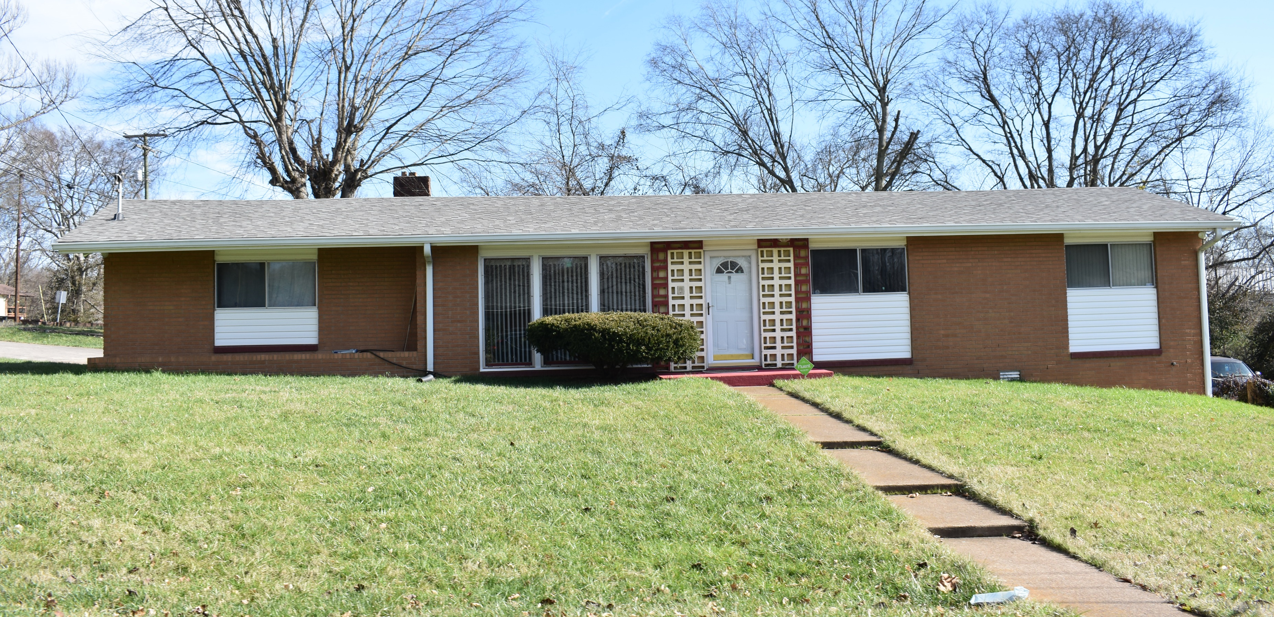
Lathan-Youngs
Free Silver Plan – 1909
Youngs Lane – late 1920s
Lathan Court – late 1950s
Home dates: 1953-1970
Ranch, Split Level
Significant connections: development of North Nashville by African American community; mid-century architecture
Residents included leaders: developer William Lathan, Nashville’s first Black police officer, and the well-known Swett family

Slide 15
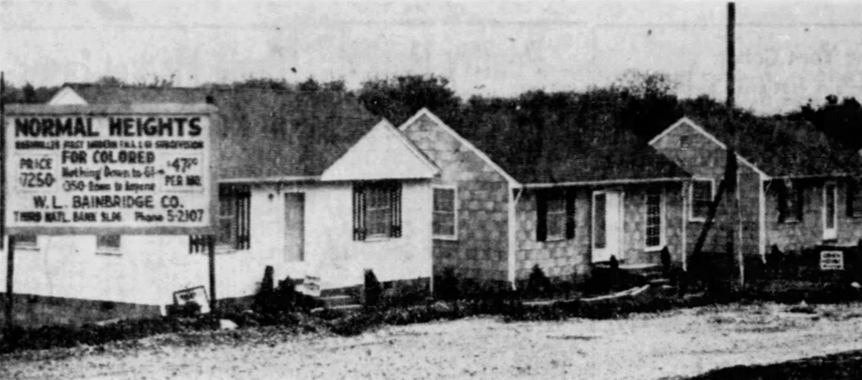
Mid-20th Century African American Historic Districts
Multiple Property Documentation Form and
National Register of Historic Places Nomination
Robbie D. Jones
Principal Senior Architectural Historian and Tennessee Branch Manager
Sydney Schoof
Senior Architectural Historian
Damita Chavis-Fielder
Community Engagement Specialist

Slide 16
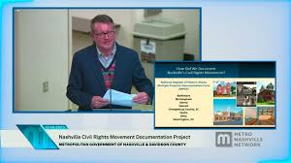
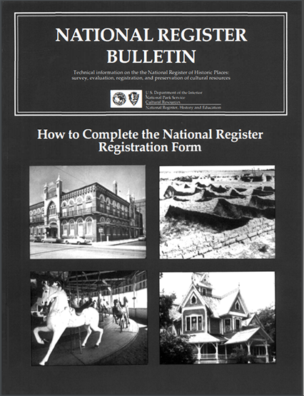

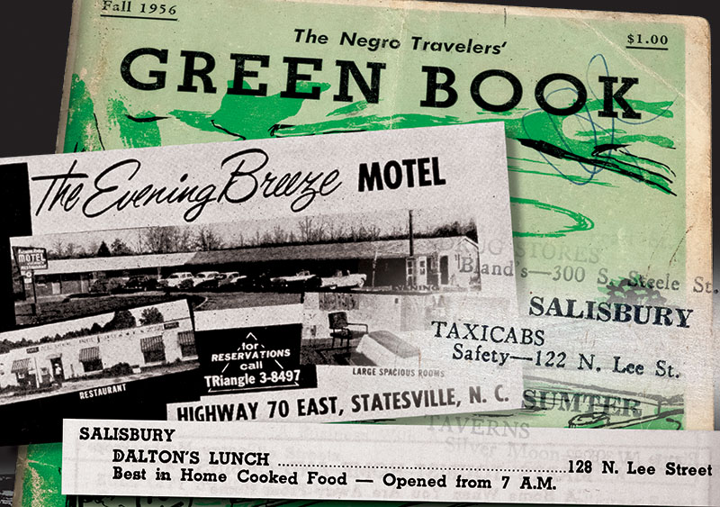
What is a Multiple Property Documentation Form?
Cover document that addresses themes, trends, and patterns of history shared by historic properties within context
Serves as an evaluation tool for determining significance of thematically related properties by establishing registration requirements
Creates property types

Slide 17
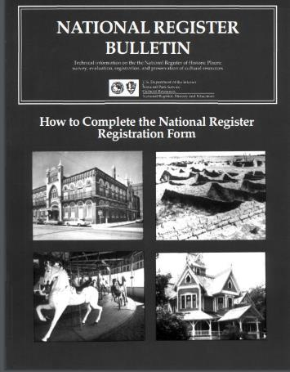
What is the National Register of Historic Places?​
The National Register is the official list of the nation's historic places worthy of preservation.
Authorized by the National Historic Preservation Act of 1966, there are more than 95,000 places representing more than 1.4 million individual resources listed.
Fewer than 4 percent of places are listed in the National Register specifically for African American history.

Slide 18
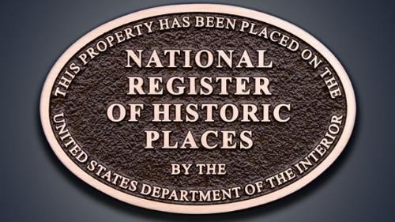
What does National Register listing do?
Identify a property is an important part of America’s cultural heritage and worthy of preservation.​
​Make the public aware of important places by documenting their significance.
Qualify income-producing properties for rehabilitation tax credits. ​
Limit or mitigate impacts of federally funded or permitted projects on historic places.

Slide 19
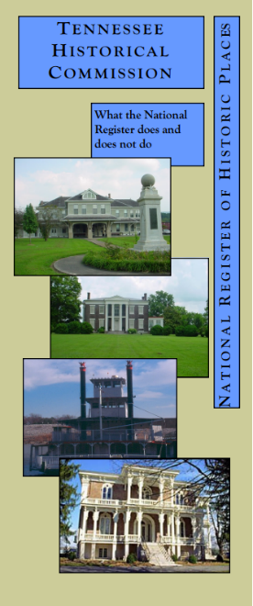
What does National Register listing NOT do?
Require repairs, restoration, or maintenance by private property owners.
Prevent alterations or demolitions by private property owners.
Raise property taxes.
Require property owners to open their homes for tours.

Slide 20
How does a place qualify as “historic”?
Significance Integrity
Criterion A: History
Criterion B: Important Person
Criterion C: Architecture and Design
Criterion D: Archaeology
location
design
setting
materials
workmanship
feeling
association
At least 50 years old (usually)

Slide 21
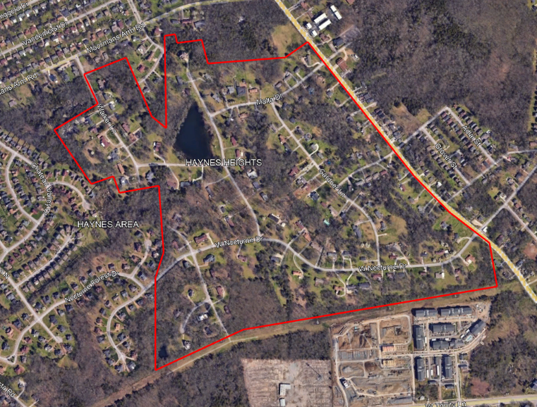
Haynes Heights
Neighborhood
About 140 houses built from 1955 to 1975
Wilkinson Cemetery established 1820
5-acre lake
Curvilinear streets

Slide 22
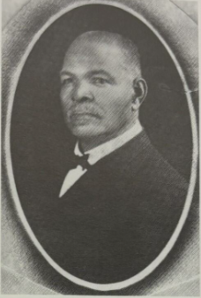
Rev. William Haynes
Born 1850 to an enslaved woman and her enslaver.
Became an educator, minister, and real estate developer
Pastor of the Sylvan Street Baptist Church
Helped relocate Roger Williams University campus (now American Baptist College) to North Nashville
Donated land for the Haynes Elementary School in 1931
1850-1933

Slide 23
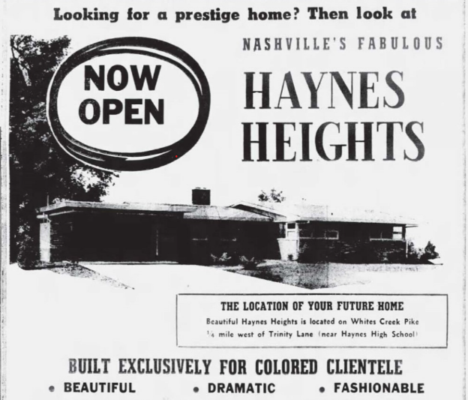
A New Neighborhood
County approved development in 1954
Deed restrictions disallowed livestock, barns, trailers, “noxious or offensive operations”
Required large front yards, minimum dwelling size
Attracted prosperous members of Nashville’s Black community

Slide 24
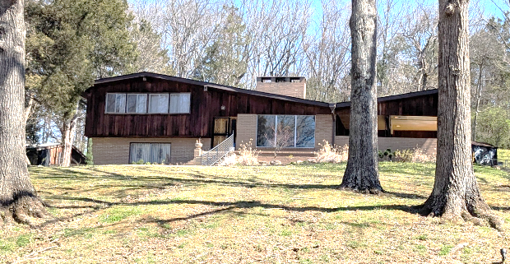
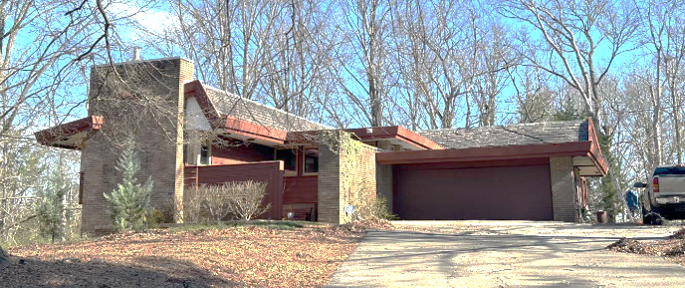
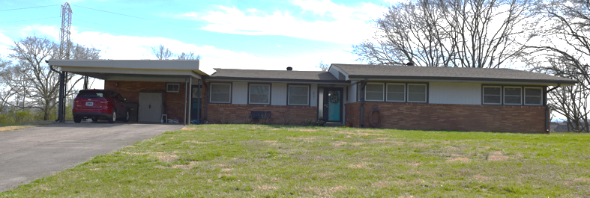
Mid-Century Design

Slide 25
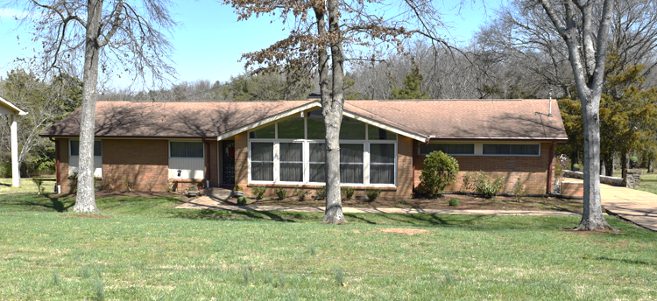
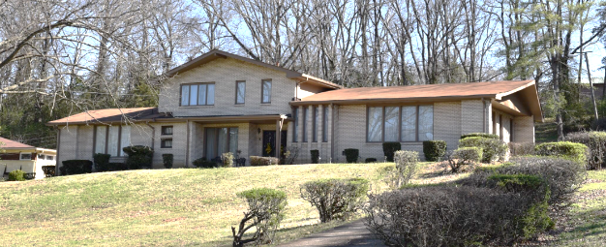
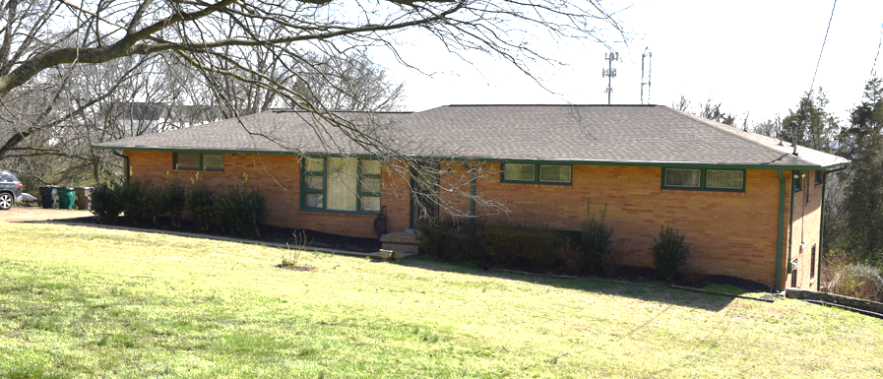
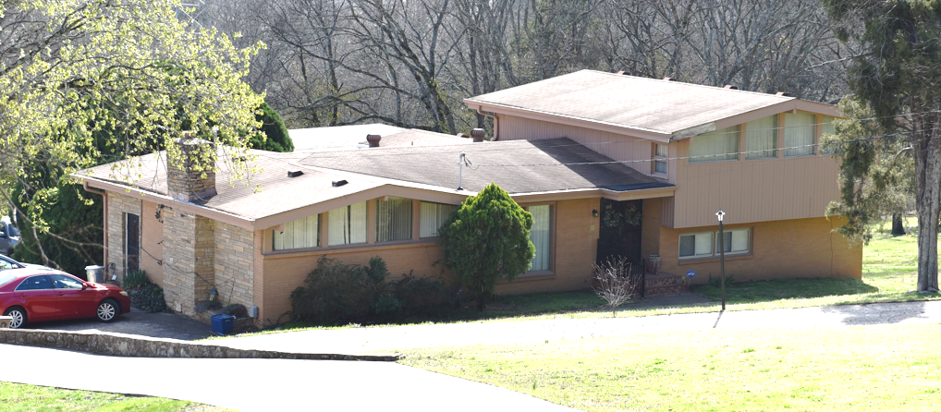

Slide 26
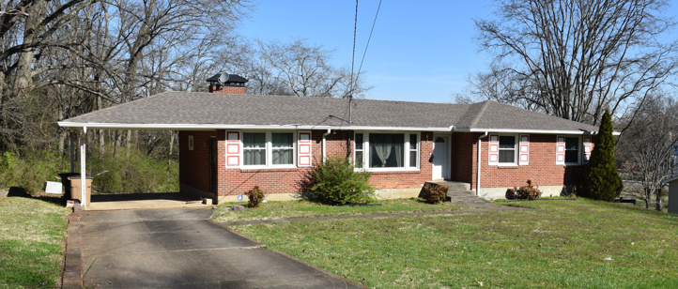
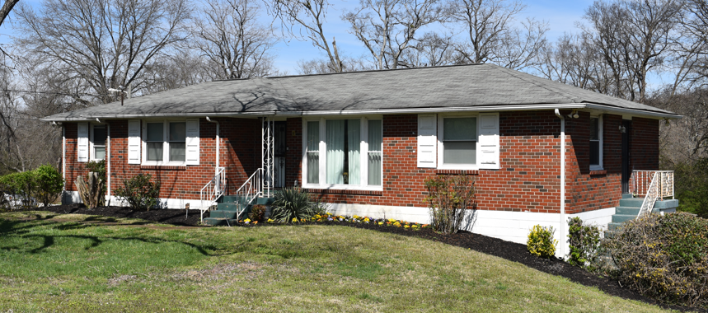
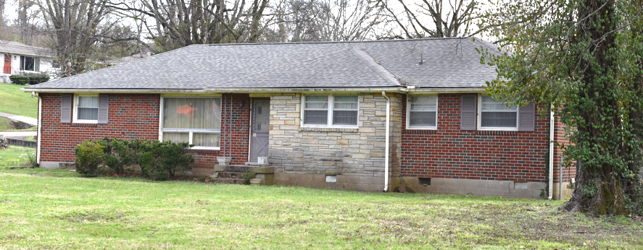
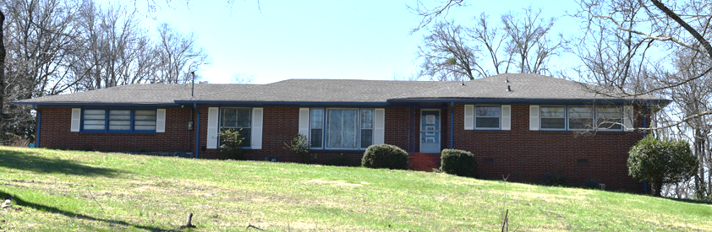

Slide 27
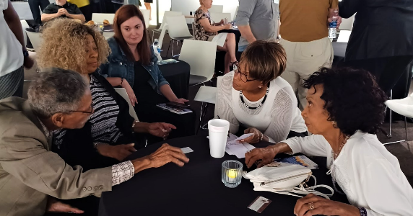


Community Engagement

Slide 28

How can you help?
Learn more about the project on MHC’s Grants and Special Projects page
Follow MHC’s social media for updates
Sign up for History Gram monthly
e-newsletter
Contact us to share info about your property or neighborhood’s history (historic images, original plans, architect/builder info)
Questions? Contact Caroline Eller at (615) 862-7970 ext. 79780
Project team: nashville@rgaincorporated.com

Slide 29

Thank You!

